Slide 1


Computational and Theoretical Study of Disordered Systems
Xiang Cheng
Department of Physics, Emory University
PhD Dissertation Defense
09/23/2016
Supported by the NSF through Grant No. DMR-1207431
Notes:
Thanks for coming.
Generally, better explanations; more to-the-point;

Slide 2
Outline
Introduction of Disordered Systems
Jamming in Hierarchical Networks (HNs)
Antiferromagnetic Ising model in HNs
Aging in Random Field Ising Model
Summary
Notes:
Today, I will first generally introduce disordered systems; then I will explain 3 projects on 3 specific disordered systems; in the end, it is the summary and conclusion.

Slide 3
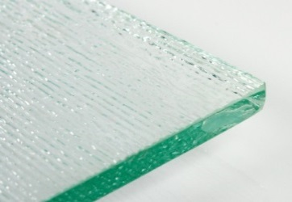

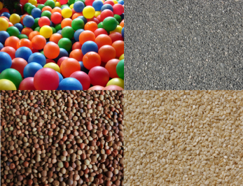
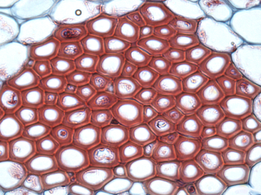
Introduction
Disordered material is the majority
Numerous categories:
Glass, polymer, granular materials, biological tissues, etc.
More unclear questions
Focus on theoretical models
Lattice glass model
Antiferromagnetic Ising model
Random Field Ising model
Notes:
Add pictures;
Most materials in the world may be classified as ordered and disordered materials. For example, crystal is an ordered material, and glass is disordered materials. Usually, there is only one possibility for an ordered material; but disordered material could have infinite possibility. So disorderd material is majority; however it is less studied and there are more questions that are unclear. And these questions

Slide 4
Outline
Introduction of Disordered Systems
Jamming in Hierarchical Networks (HNs)
Antiferromagnetic Ising model in HNs
Aging in Random Field Ising Model
Summary

Slide 5
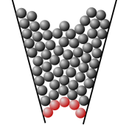

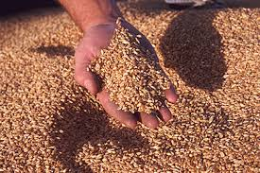

Jamming transition
Jammed states are common.
Characteristics
High packing density (not highest)
Out of equilibrium
Extremely slow relaxation
A challenge to understand
What causes the extremely slow relaxation?
Equilibrium state?
Equilibrium phase transition?
Zhang, .et al and Liu, Nature 459, 230 (2009)

Slide 6
Model: lattice glass model
Biroli-Mezard Model (BM)
Structural disorder → Complex Dynamics
Biroli and Mezard, PRL 88, 2 (2002); Krzakala, Tarzia, and Zdeborova, PRL 101, 165702 (2008)
Notes:
Simple model -> complex and interesting dynamics
Mu -> temperature

Slide 7
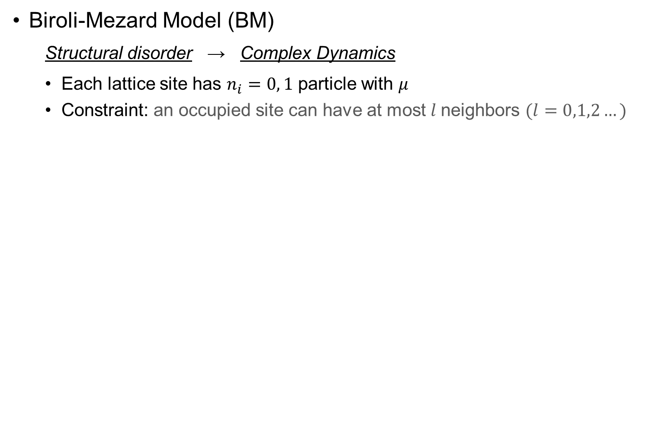
Model: lattice glass model
Biroli-Mezard Model (BM)
Structural disorder → Complex Dynamics
Each lattice site has $n_{i}=0, 1$ particle with $μ$
Constraint: an occupied site can have at most $l$neighbors $(l=0,1,2…)$
Biroli and Mezard, PRL 88, 2 (2002); Krzakala, Tarzia, and Zdeborova, PRL 101, 165702 (2008)
Notes:
Simple model -> complex and interesting dynamics
Mu -> temperature

Slide 8

Model: lattice glass model
Biroli-Mezard Model (BM)
Structural disorder → Complex Dynamics
Each lattice site has $n_{i}=0, 1$ particle with $μ$
Constraint: an occupied site can have at most $l$neighbors $(l=0,1,2…)$
Example: $l=0$
Biroli and Mezard, PRL 88, 2 (2002); Krzakala, Tarzia, and Zdeborova, PRL 101, 165702 (2008)
Notes:
Simple model -> complex and interesting dynamics
Mu -> temperature

Slide 9
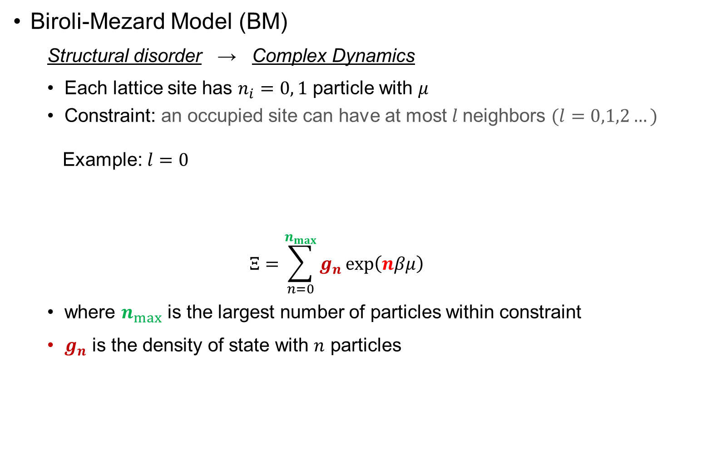
Model: lattice glass model
Biroli-Mezard Model (BM)
Structural disorder → Complex Dynamics
Each lattice site has $n_{i}=0, 1$ particle with $μ$
Constraint: an occupied site can have at most $l$neighbors $(l=0,1,2…)$
Example: $l=0$
$$Ξ=\sum_{n=0}^{n_{max}}{g_{n}\exp\left(nβμ\right)}$$
where $n_{max}$ is the largest number of particles within constraint
$g_{n}$ is the density of state with $n$ particles
Biroli and Mezard, PRL 88, 2 (2002); Krzakala, Tarzia, and Zdeborova, PRL 101, 165702 (2008)
Notes:
Simple model -> complex and interesting dynamics
Mu -> temperature

Slide 10
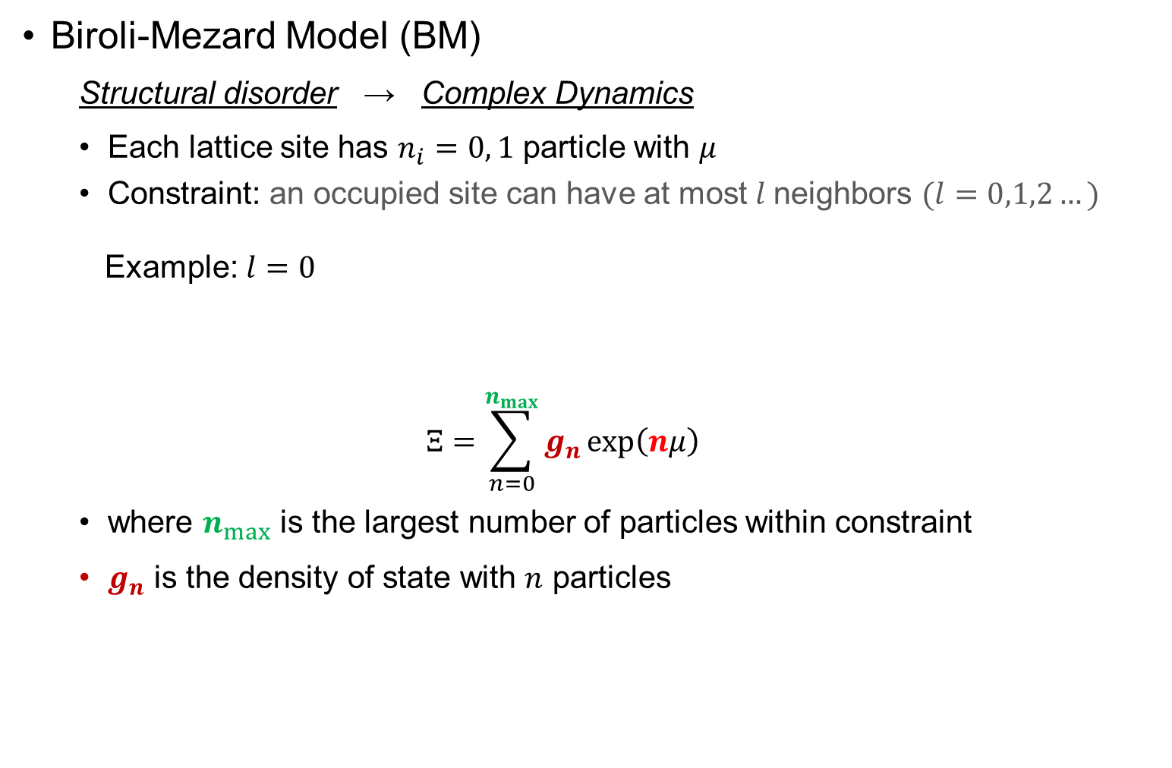
Model: lattice glass model
Biroli-Mezard Model (BM)
Structural disorder → Complex Dynamics
Each lattice site has $n_{i}=0, 1$ particle with $μ$
Constraint: an occupied site can have at most $l$neighbors $(l=0,1,2…)$
Example: $l=0$
$$Ξ=\sum_{n=0}^{n_{max}}{g_{n}\exp\left(nμ\right)}$$
where $n_{max}$ is the largest number of particles within constraint
$g_{n}$ is the density of state with $n$ particles
Biroli and Mezard, PRL 88, 2 (2002); Krzakala, Tarzia, and Zdeborova, PRL 101, 165702 (2008)
Notes:
Simple model -> complex and interesting dynamics
Mu -> temperature

Slide 11
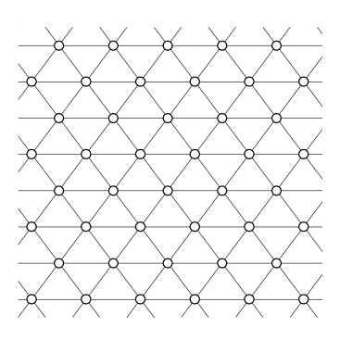
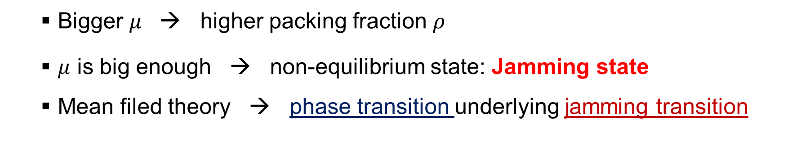
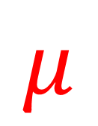
Jamming in lattice glass model
$$μ$$
Bigger $μ$ → higher packing fraction $ρ$
$μ$ is big enough → non-equilibrium state: Jamming state
Mean filed theory → phase transition underlying jamming transition
Biroli and Mezard, PRL 88, 2 (2002); Krzakala, Tarzia, and Zdeborova, PRL 101, 165702 (2008)

Slide 12
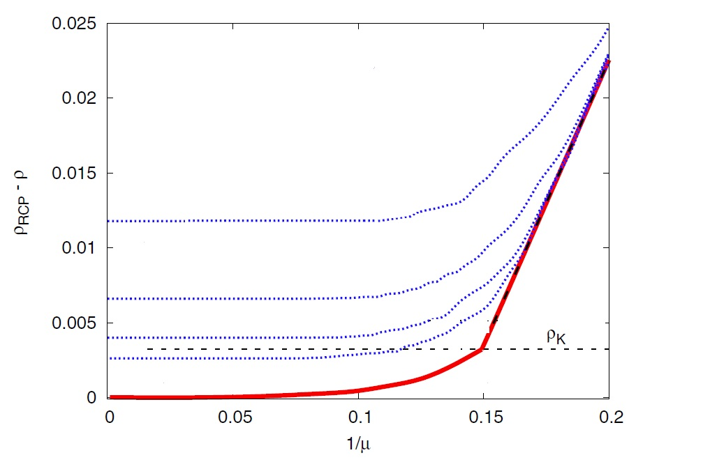
Equilibrium phase transition Jamming Transition?
Mean-field model
Phase transition found underlying jamming transition
True in non-mean-filed model?
Krzakala, Tarzia, and Zdeborova, PRL 101, 165702 (2008)

Slide 13
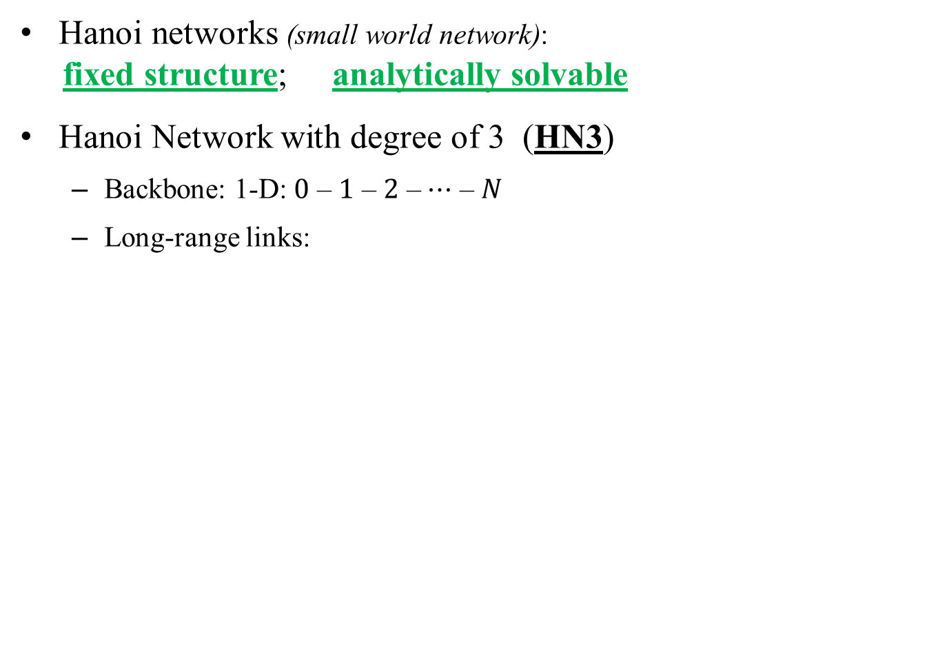
Model: Hierarchical Networks
Hanoi networks (small world network):
fixed structure; analytically solvable
Hanoi Network with degree of 3 (HN3)
Backbone: 1-D: $0$ – $1$ – $2$ – $⋯$ – $N$
Long-range links:
S. Boettcher, B. Goncalves, and H. Guclu, J. Phys. A 41, 252001 (2008)

Slide 14
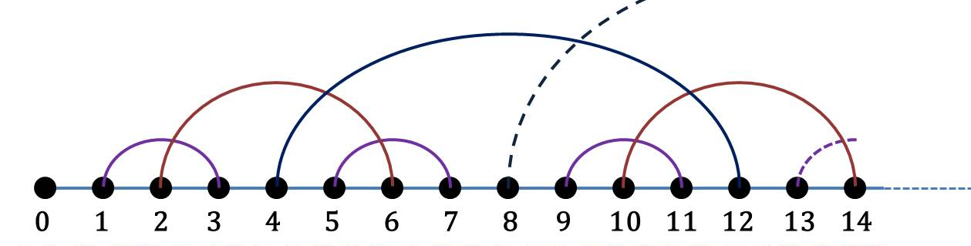
Model: Hierarchical Networks
Hanoi networks (small world network):
fixed structure; analytically solvable
Hanoi Network with degree of 3 (HN3)
Backbone: 1-D: $0$ – $1$ – $2$ – $⋯$ – $N$
Long-range links:
S. Boettcher, B. Goncalves, and H. Guclu, J. Phys. A 41, 252001 (2008)

Slide 15
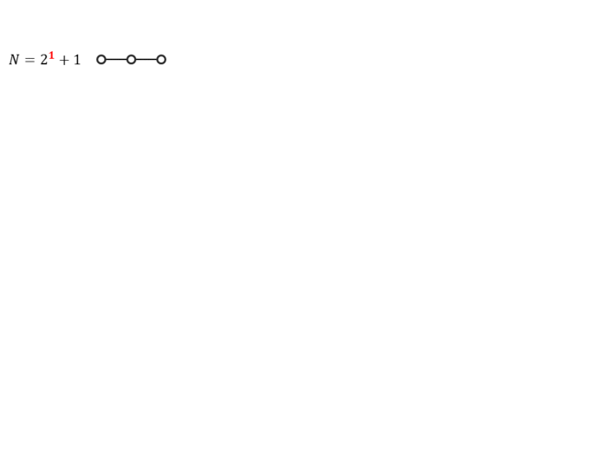
Model: Hierarchical Networks
Hanoi networks (small world network):
fixed structure; analytically solvable
Hanoi Network with degree of 3 (HN3)
Backbone: 1-D: $0$ – $1$ – $2$ – $⋯$ – $N$
Long-range links:
S. Boettcher, B. Goncalves, and H. Guclu, J. Phys. A 41, 252001 (2008)

Slide 16
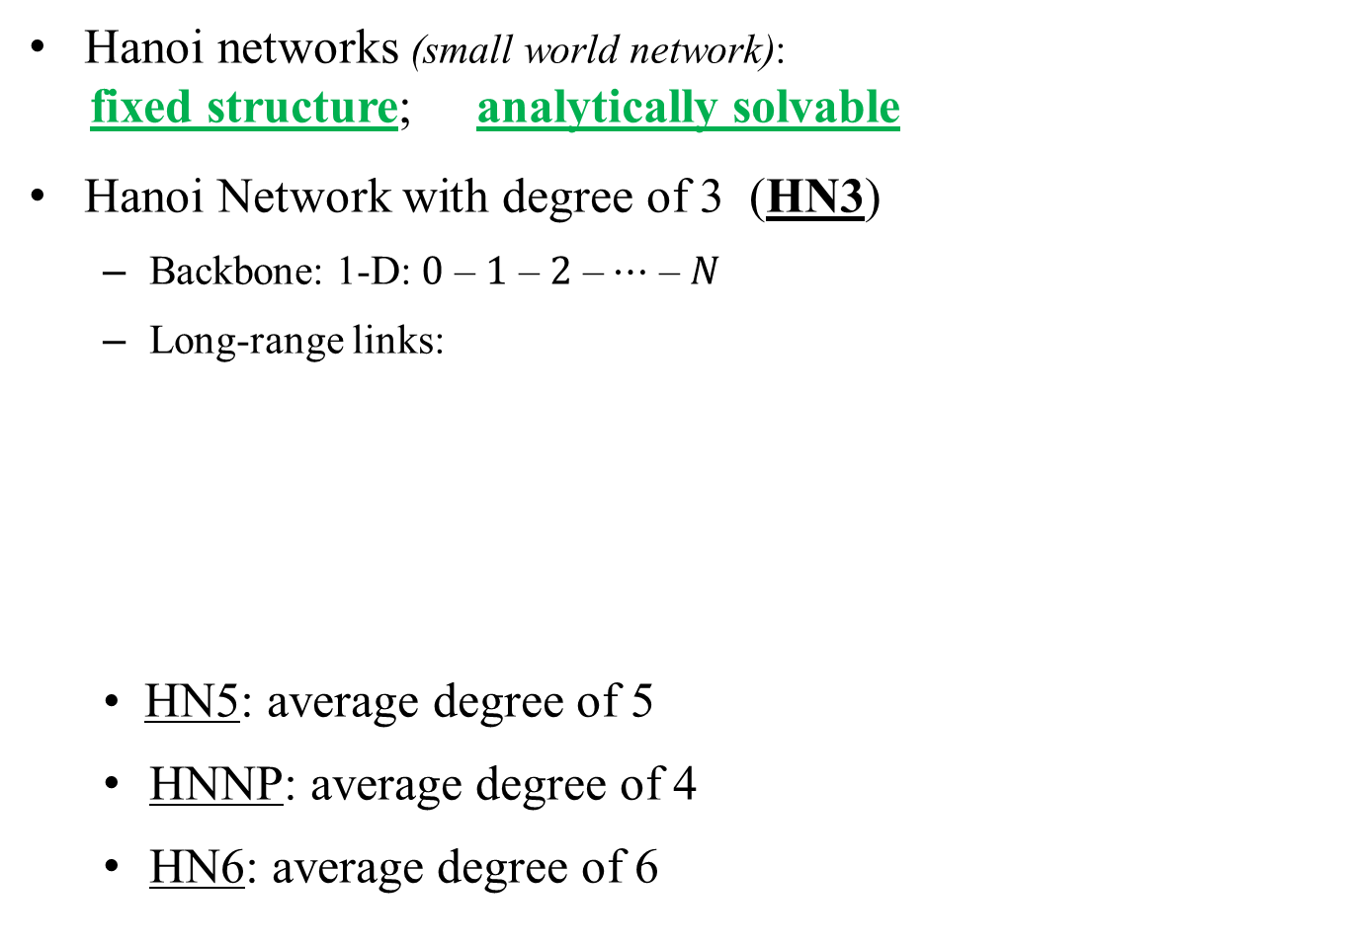
Model: Hierarchical Networks
Hanoi networks (small world network):
fixed structure; analytically solvable
Hanoi Network with degree of 3 (HN3)
Backbone: 1-D: $0$ – $1$ – $2$ – $⋯$ – $N$
Long-range links:
• HN5: average degree of 5
HNNP: average degree of 4
HN6: average degree of 6
S. Boettcher, B. Goncalves, and H. Guclu, J. Phys. A 41, 252001 (2008)

Slide 17
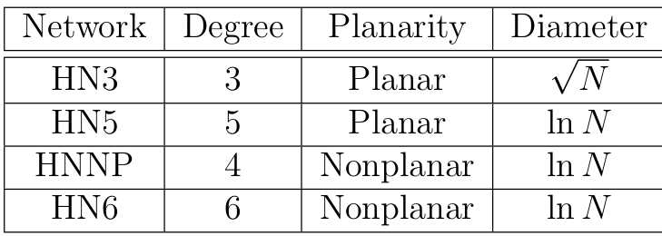
Why Hierarchical Networks (HNs)?
Exactly solvable by Renormalization Group (RG)
Lattice-like structure
Mean-Field HNs Regular lattice
Different structures

Slide 18
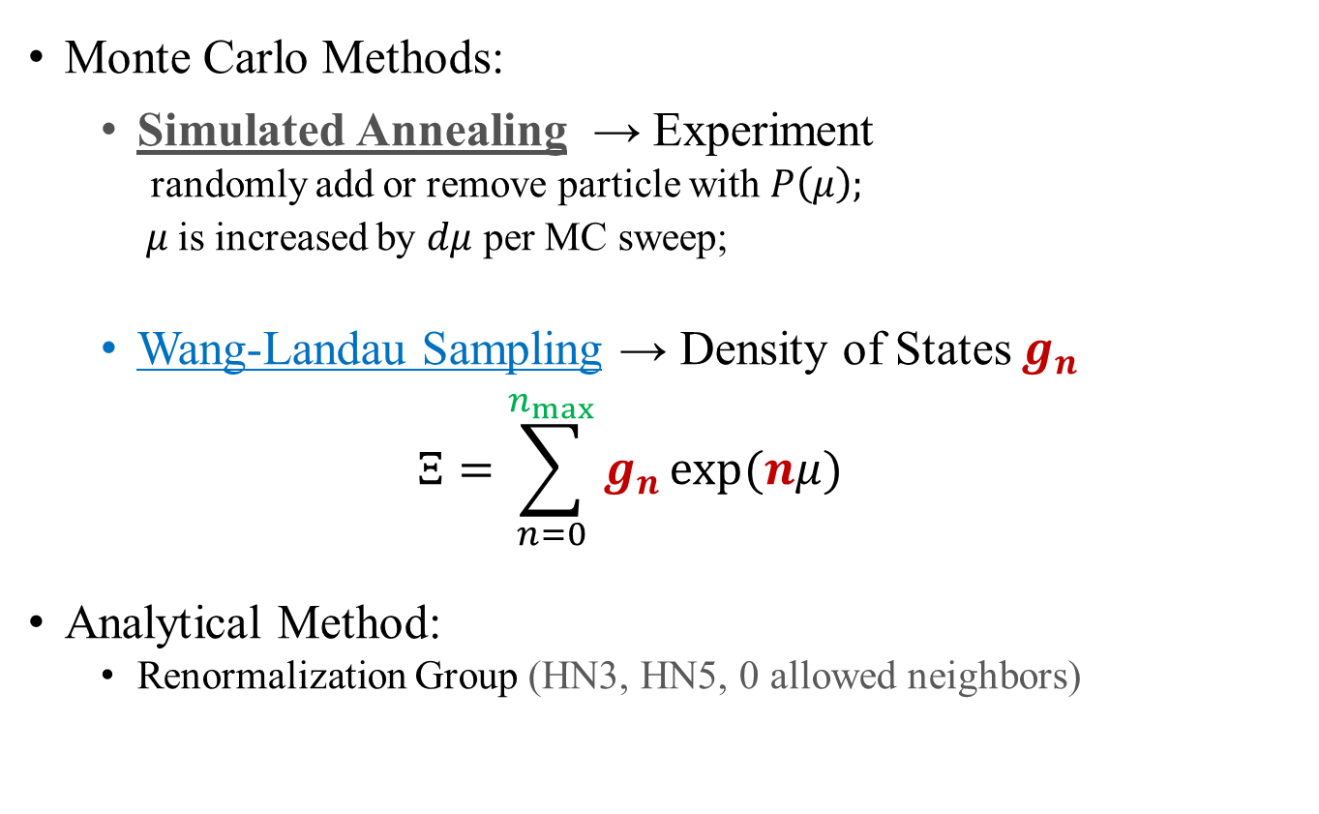
Methods
Monte Carlo Methods:
Simulated Annealing → Experiment
randomly add or remove particle with $P\left(μ\right);$
$μ$is increased by $dμ$ per MC sweep;
Wang-Landau Sampling → Density of States $g_{n}$
$$Ξ=\sum_{n=0}^{n_{max}}{g_{n}}\exp{(nμ)}$$
Analytical Method:
Renormalization Group (HN3, HN5, 0 allowed neighbors)
Notes:
The probability is Boltzmann equation

Slide 19
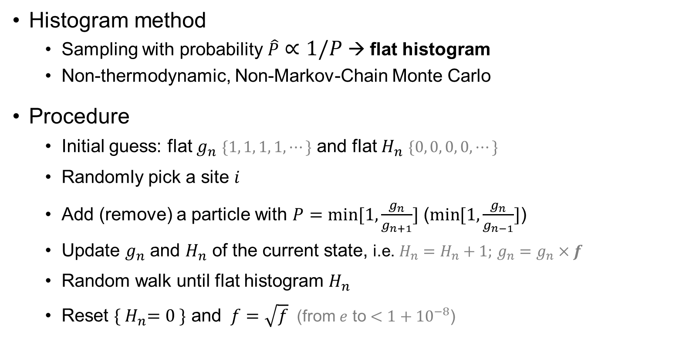
Wang-Landau sampling
Histogram method
Sampling with probability $\hat{P}∝1/P$ → flat histogram
Non-thermodynamic, Non-Markov-Chain Monte Carlo
Procedure
Initial guess: flat $g_{n}$ $\{1, 1, 1, 1,⋯\}$ and flat $H_{n}$ $\{0, 0, 0, 0,⋯\}$
Randomly pick a site $i$
Add (remove) a particle with $P=\min{[1,\frac{g_{n}}{g_{n+1}}]}$ ($\min{[1,\frac{g_{n}}{g_{n−1}}]}$)
Update $g_{n}$ and $H_{n}$ of the current state, i.e. $H_{n}=H_{n}+1;$ $g_{n}=g_{n}×f$
Random walk until flat histogram $H_{n}$
Reset ${\{ H}_{n}=0 \}$ and $f=\sqrt{f}$(from $e$ to $<1+{10}^{−8}$)
Notes:
Extra slides

Slide 20
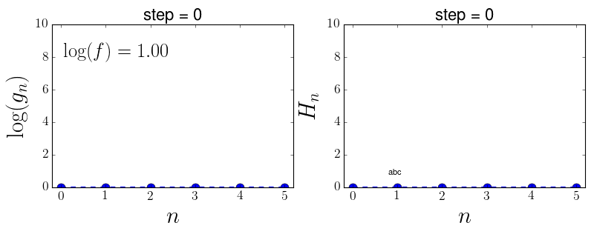
Wang-Landau sampling
Notes:
Extra slides

Slide 21
Wang-Landau sampling
Extremely slow for large system size
Notes:
Extra slides

Slide 22
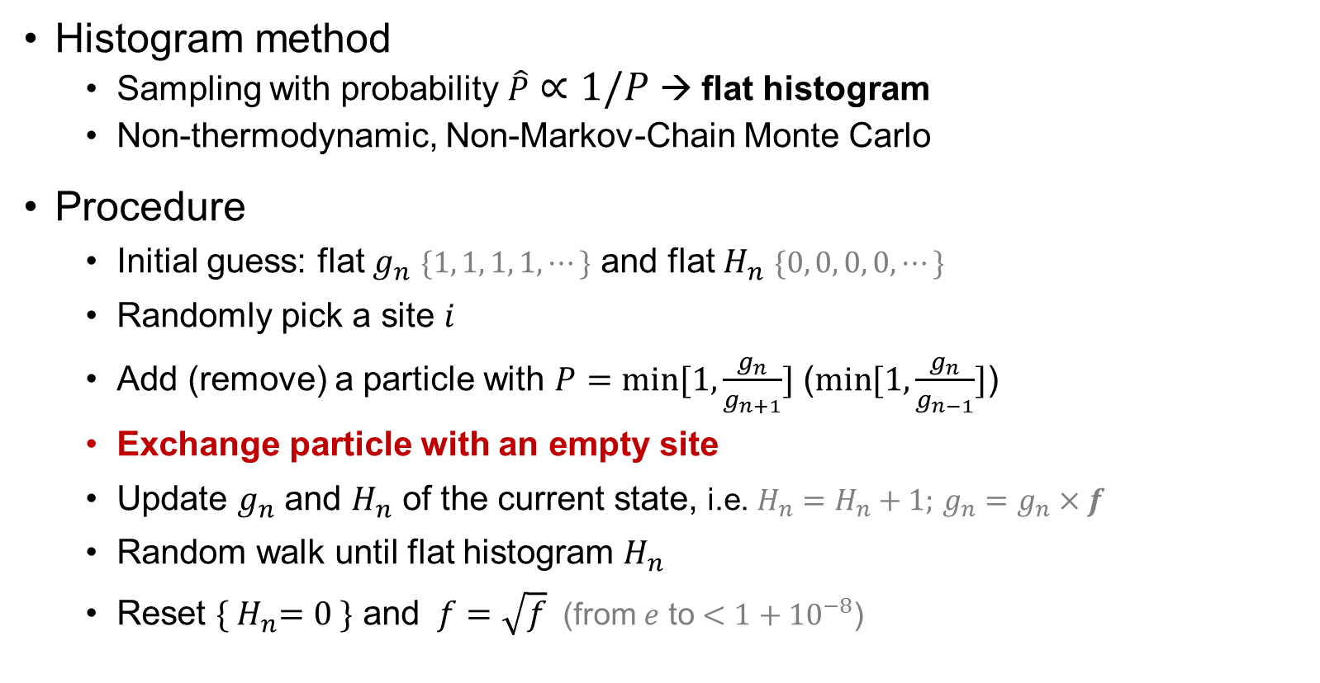
Wang-Landau sampling
Histogram method
Sampling with probability $\hat{P}∝1/P$ → flat histogram
Non-thermodynamic, Non-Markov-Chain Monte Carlo
Procedure
Initial guess: flat $g_{n}$ $\{1, 1, 1, 1,⋯\}$ and flat $H_{n}$ $\{0, 0, 0, 0,⋯\}$
Randomly pick a site $i$
Add (remove) a particle with $P=\min{[1,\frac{g_{n}}{g_{n+1}}]}$ ($\min{[1,\frac{g_{n}}{g_{n−1}}]}$)
Exchange particle with an empty site
Update $g_{n}$ and $H_{n}$ of the current state, i.e. $H_{n}=H_{n}+1;$ $g_{n}=g_{n}×f$
Random walk until flat histogram $H_{n}$
Reset ${\{ H}_{n}=0 \}$ and $f=\sqrt{f}$(from $e$ to $<1+{10}^{−8}$)
Notes:
Extra slides

Slide 23
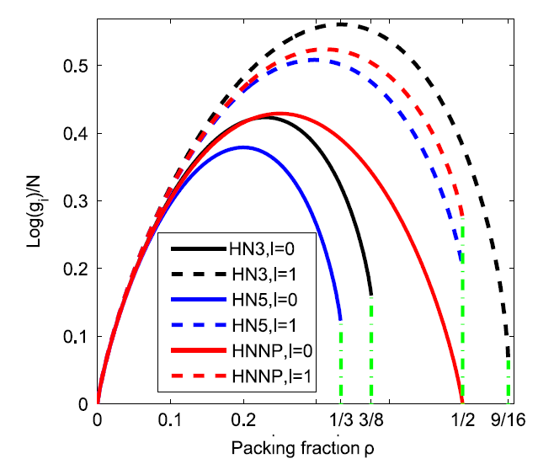
Results of Wang-Landau sampling
N=512
Does NOT converge for larger system size
Notes:
Ground states & Why Wang-Landau fails

Slide 24
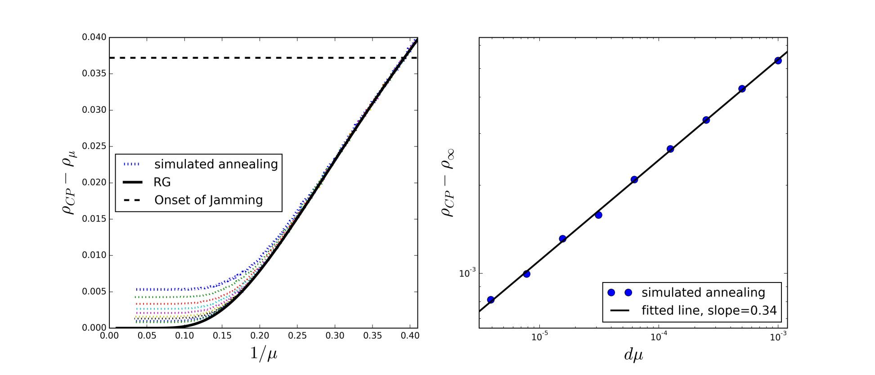

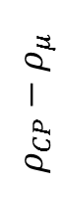
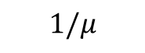
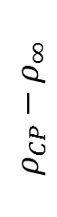
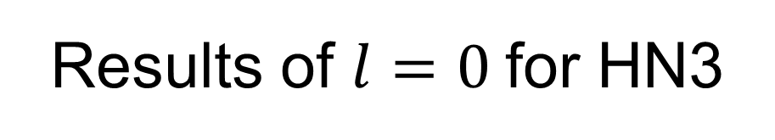
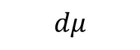
Results of $l=0$for HN3
Simulated annealing vs RG
Power-law relaxation
Jamming transition exists;
No Phase Transition
$$ρ_{CP}−ρ_{μ}$$
$$1/μ$$
$$ρ_{CP}−ρ_{∞}$$
$$dμ$$
Notes:
2 sentences on SA not finding the global maximization;

Slide 25
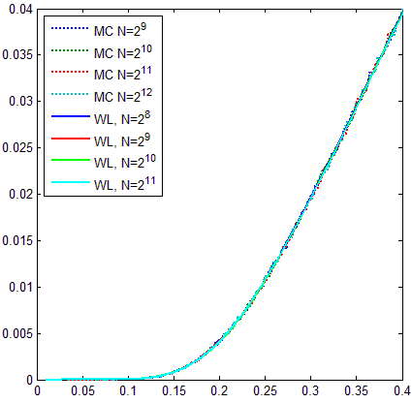
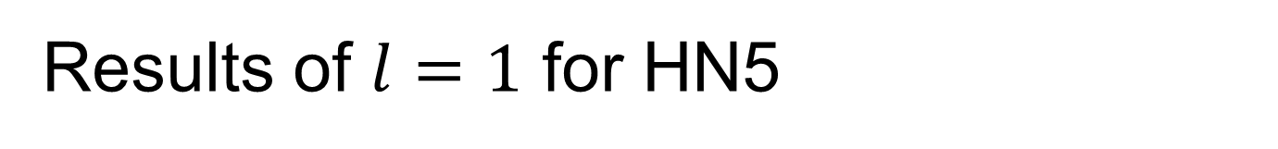
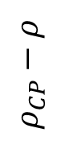
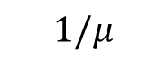
Results of $l=1$ for HN5
Simulation agrees well with Wang-Landau;
Converge faster for large system sizes;
Jamming state DOES NOT exist;
No real phase transition;
$$ρ_{CP}−ρ$$
$$1/μ$$

Slide 26
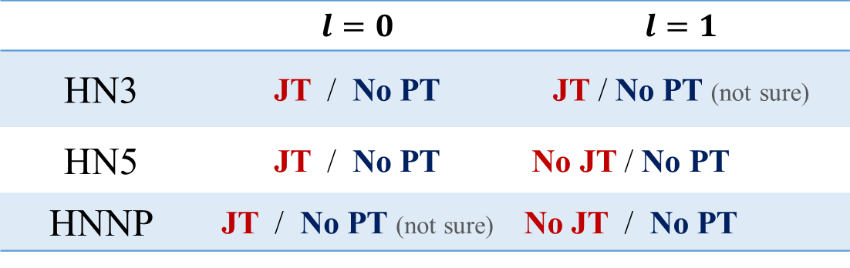
Summary and Conclusion
 | $$l=0$$ | $$l=1$$
HN3 | JT / No PT | JT / No PT (not sure)
HN5 | JT / No PT | No JT / No PT
HNNP | JT / No PT (not sure) | No JT / No PT
JT: Jamming Transition; PT: Phase Transition
Glassy dynamics & power-law relaxation & Jamming transition
Algorithm efficiency improved by more random walk
Notes:
Computational complexity; carefully

Slide 27
Summary and Conclusion
 | $$l=0$$ | $$l=1$$
HN3 | JT / No PT | JT / No PT (not sure)
HN5 | JT / No PT | No JT / No PT
HNNP | JT / No PT (not sure) | No JT / No PT
JT: Jamming Transition; PT: Phase Transition
Glassy dynamics & power-law relaxation & Jamming transition
Algorithm efficiency improved by more random walk
Jamming transition may not necessarily indicate a real phase transition
Notes:
Computational complexity; carefully

Slide 28
Outline
Introduction of Disordered Systems
Jamming in Hierarchical Networks (HNs)
Antiferromagnetic Ising model in HNs
Aging in Random Field Ising Model
Summary

Slide 29
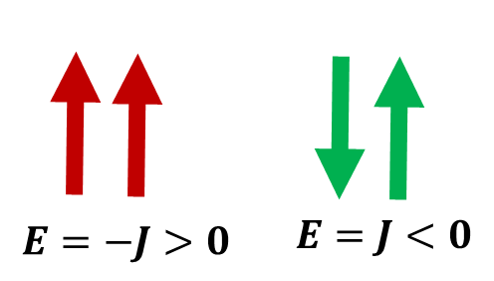
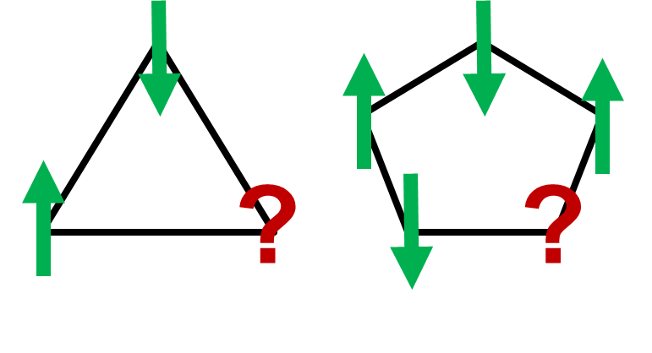
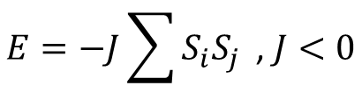
Antiferromagnetic Ising model
Antiferromagnetic Ising model
Geometric frustration: odd loops
$$E=−J\sum{S_{i}S_{j}}\text{ , }J<0$$

Slide 30
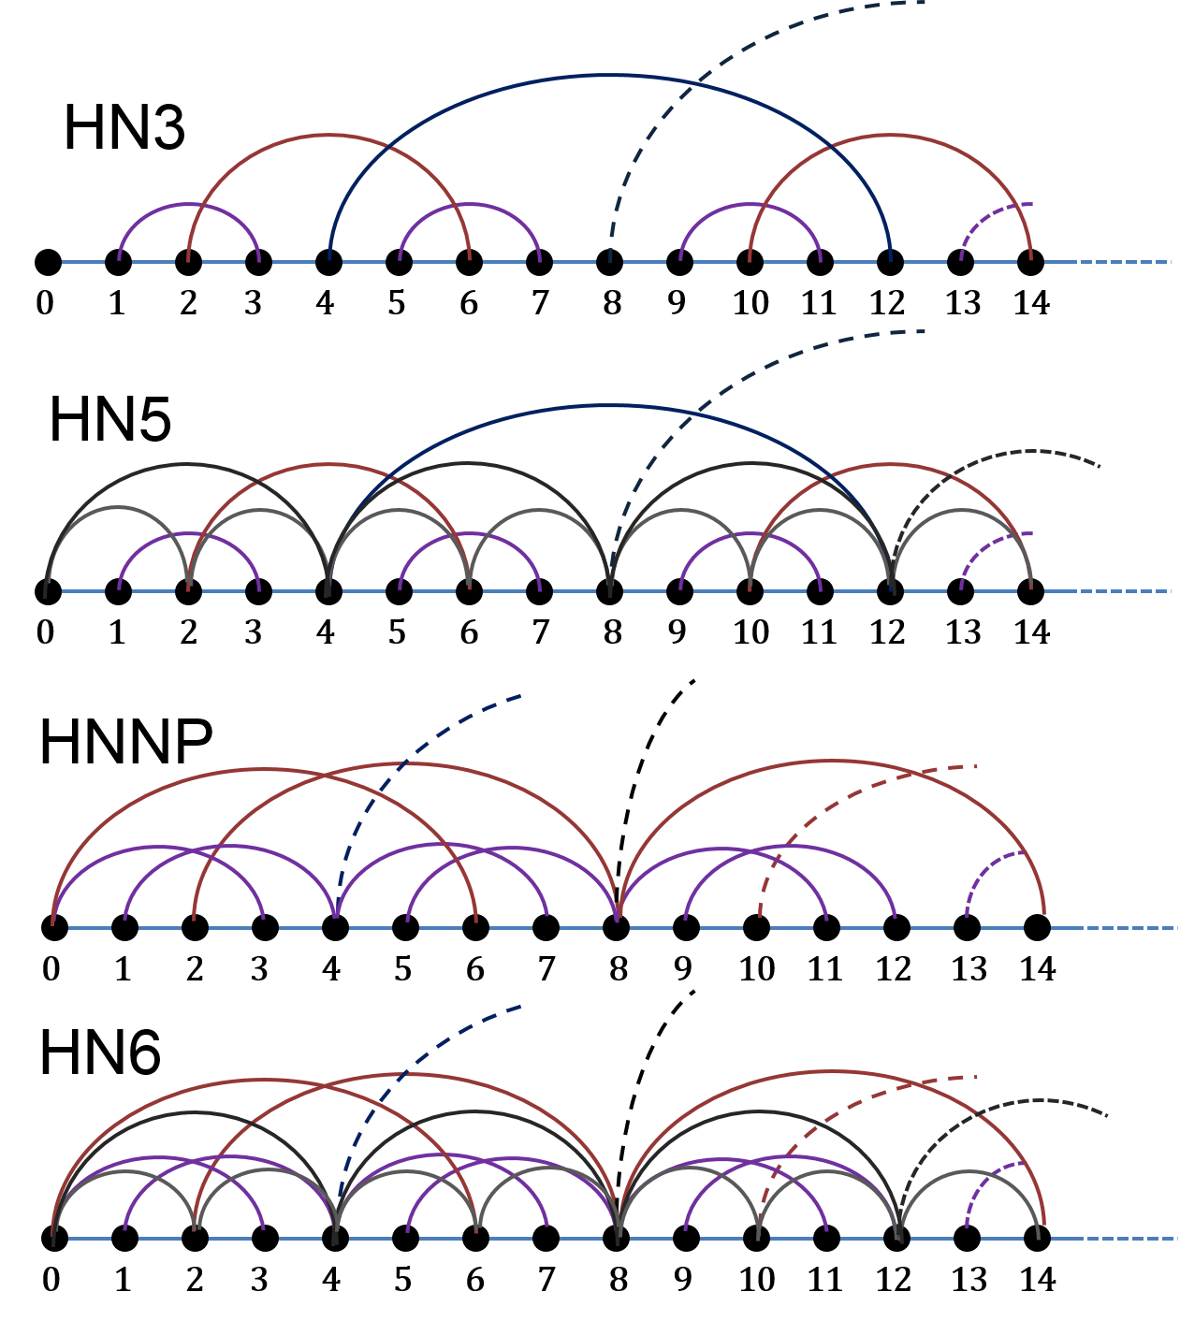
Hierarchical networks (HNs)
HN3
HN5
HNNP
HN6

Slide 31
Hierarchical networks (HNs)
HN3
HN5
HNNP
HN6

Slide 32
Hierarchical networks (HNs)
HN3
HN5
HNNP
HN6

Slide 33
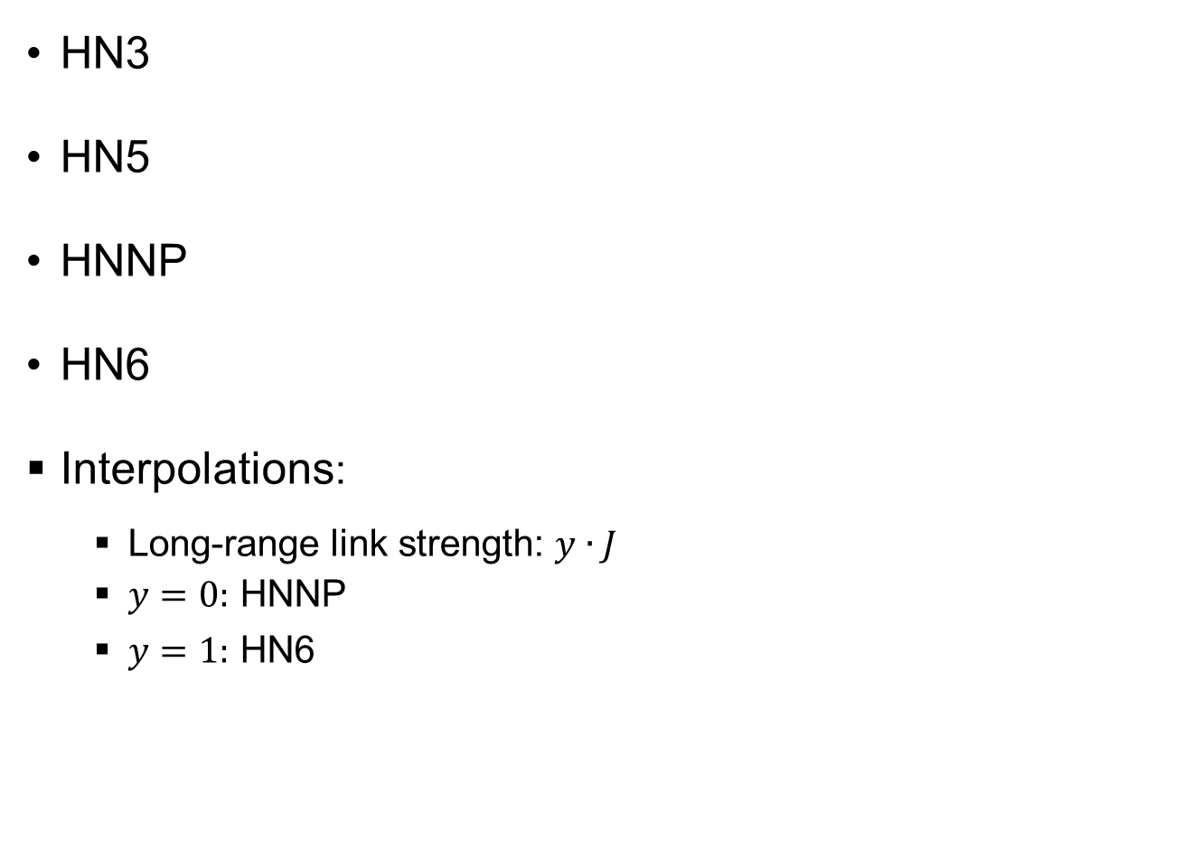
Hierarchical networks (HNs)
HN3
HN5
HNNP
HN6
Interpolations:
Long-range link strength: $y∙J$
$y=0:$ HNNP
$y=1:$ HN6

Slide 34
Research Questions
Anything interesting in this simple model?
Glassy dynamics?
Phase transitions?
Spin glass phase?
Difference to mean-field models?

Slide 35
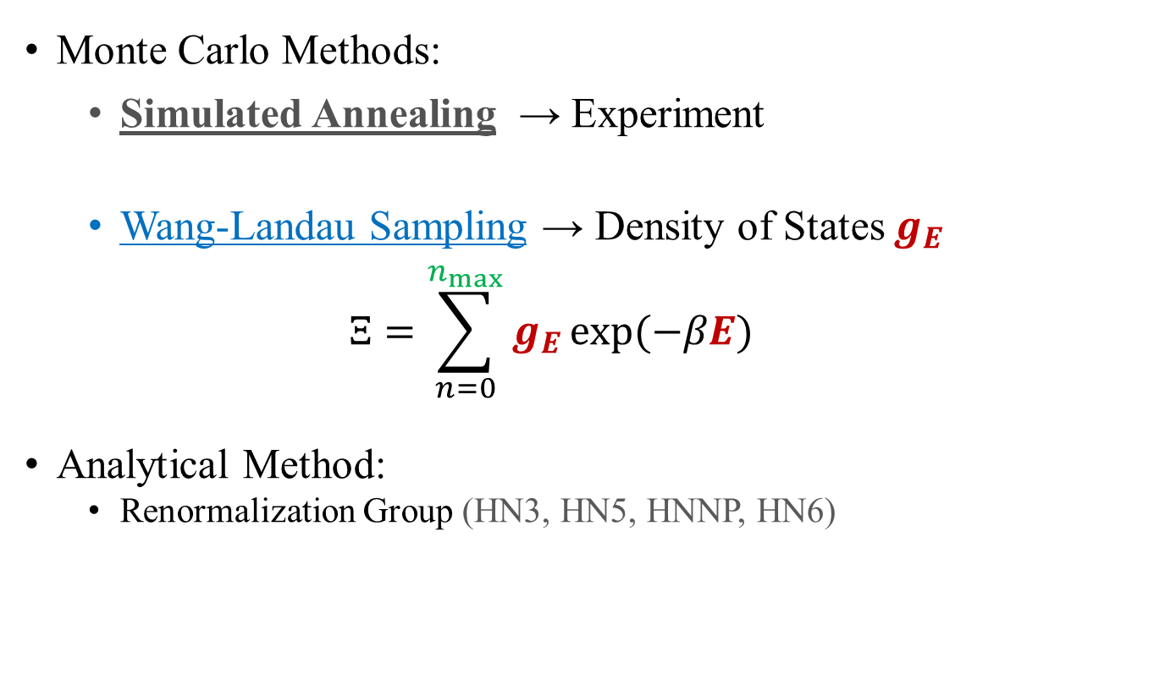
Methods
Monte Carlo Methods:
Simulated Annealing → Experiment
Wang-Landau Sampling → Density of States $g_{E}$
$$Ξ=\sum_{n=0}^{n_{max}}{g_{E}}\exp{(−βE)}$$
Analytical Method:
Renormalization Group (HN3, HN5, HNNP, HN6)

Slide 36
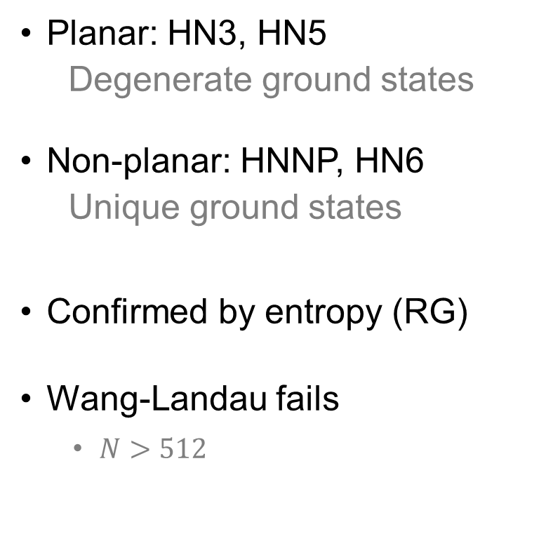
Density of States (WL)
Planar: HN3, HN5
Degenerate ground states
Non-planar: HNNP, HN6
Unique ground states
Confirmed by entropy (RG)
Wang-Landau fails
$N>512$

Slide 37
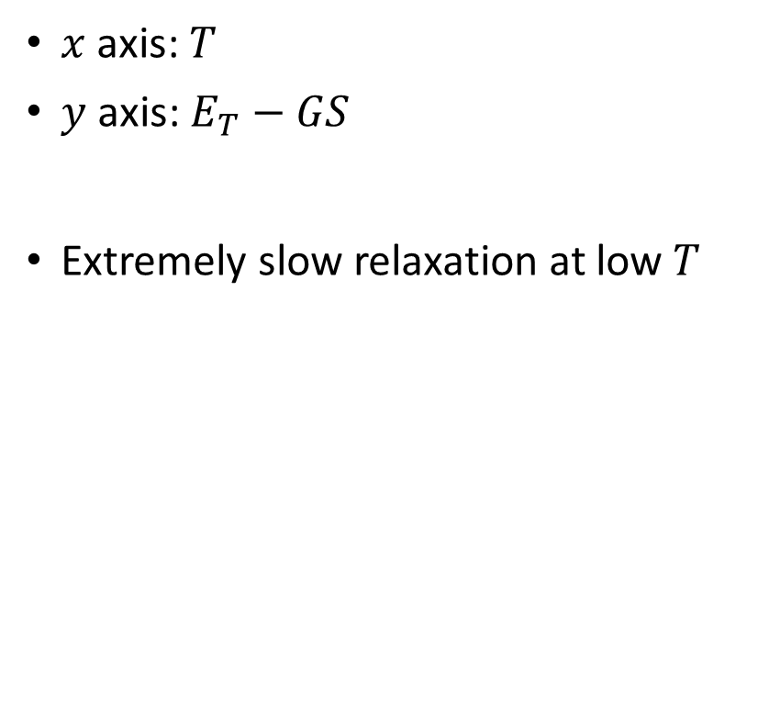
Glassy relaxation (SA)
$x$ axis: $T$
$y$ axis: $E_{T}−GS$
Extremely slow relaxation at low $T$

Slide 38
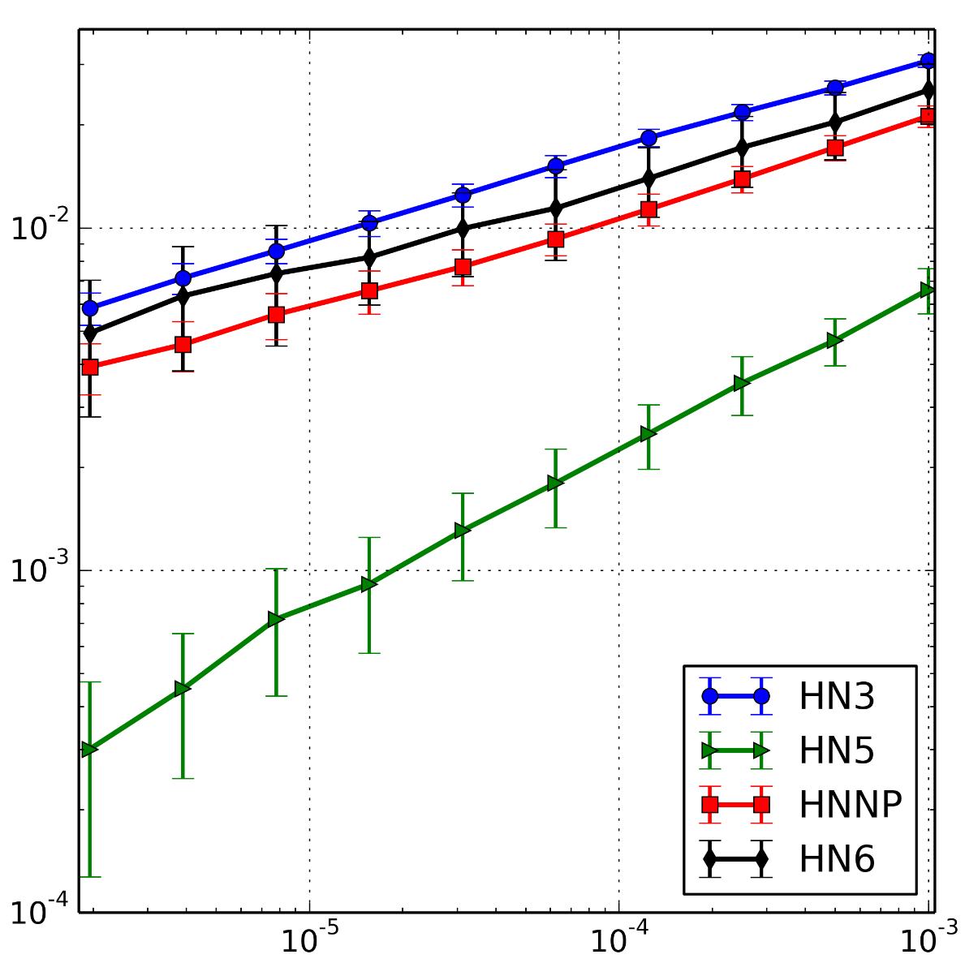
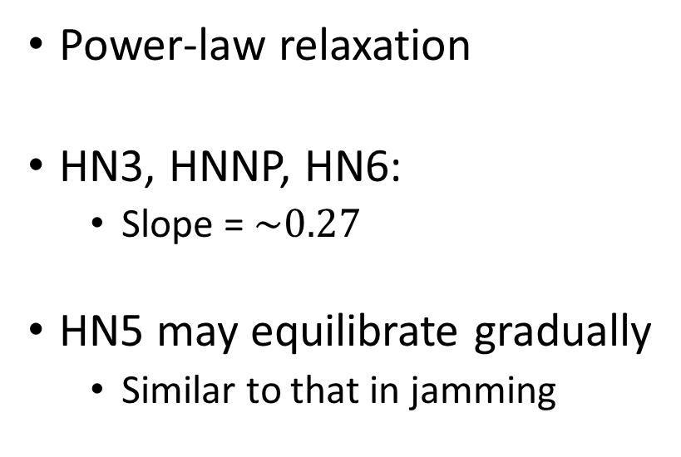
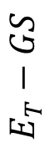
Power-law relaxation (SA)
Power-law relaxation
HN3, HNNP, HN6:
Slope = $\sim 0.27$
HN5 may equilibrate gradually
Similar to that in jamming
$$E_{T}−GS$$
$$dT$$
Notes:
Similar to Jamming case,

Slide 39
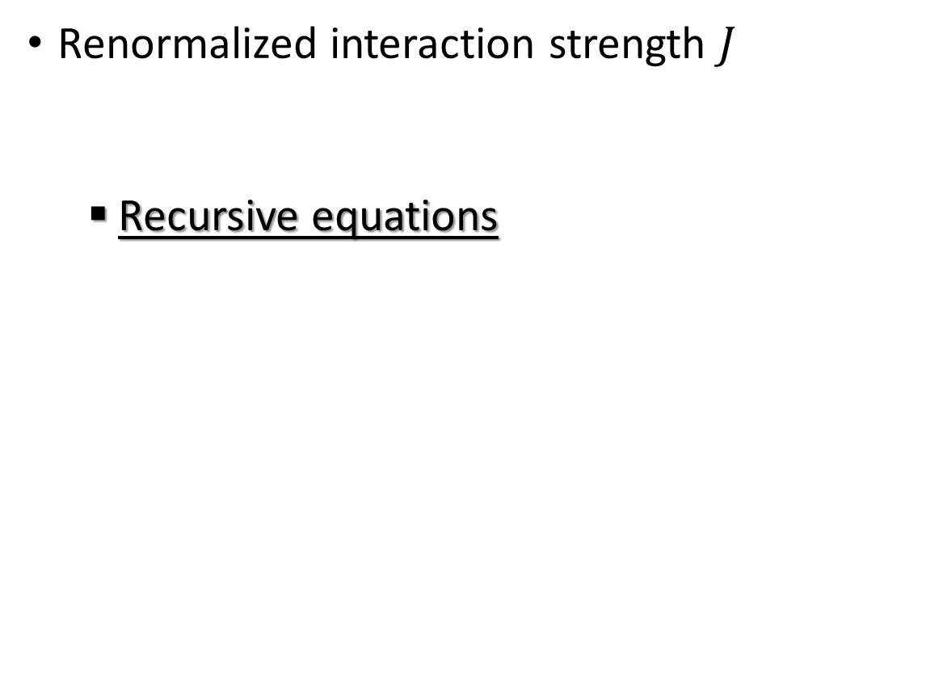
Spin glass transition (RG)
Renormalized interaction strength $J$
Recursive equations
Numerical solution
Analytical solution
McKay and Berker, Phys. Rev. Lett. 48, 11 (1982)

Slide 40
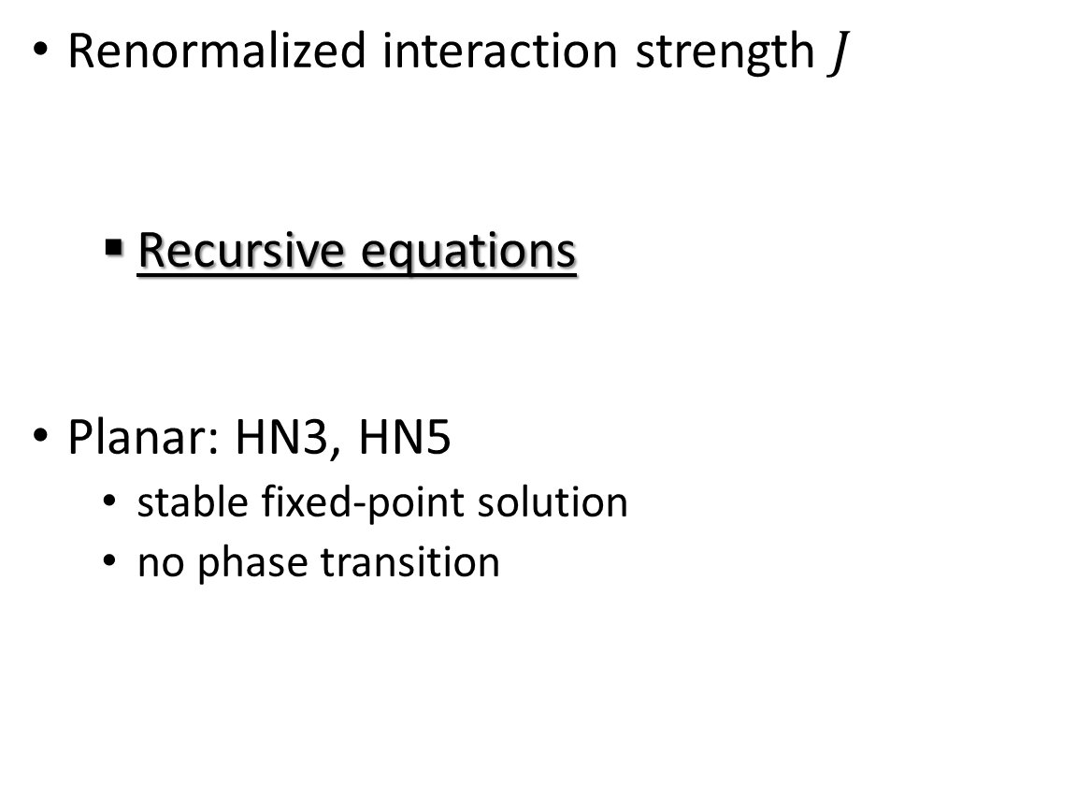
Spin glass transition (RG)
Renormalized interaction strength $J$
Recursive equations
Planar: HN3, HN5
stable fixed-point solution
no phase transition
Numerical solution
Analytical solution
McKay and Berker, Phys. Rev. Lett. 48, 11 (1982)

Slide 41
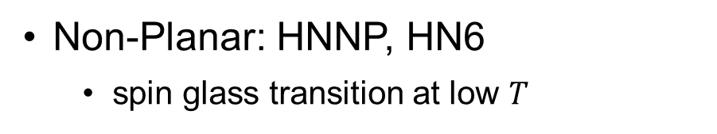
Spin glass transition (RG)
Non-Planar: HNNP, HN6
spin glass transition at low $T$
McKay and Berker, Phys. Rev. Lett. 48, 11 (1982)

Slide 42
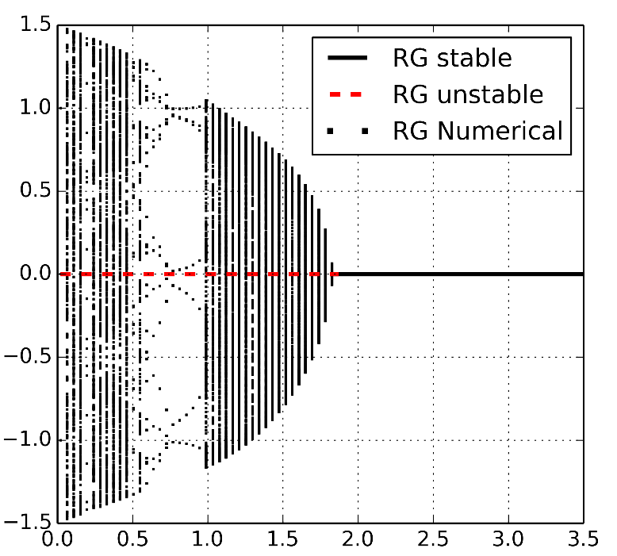
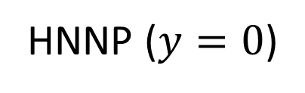
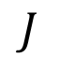

Spin glass transition (RG)
Non-Planar: HNNP, HN6
spin glass transition at low $T$
HNNP ($y=0$)
$$J$$
$$T$$
McKay and Berker, Phys. Rev. Lett. 48, 11 (1982)

Slide 43




Spin glass transition (RG)
Non-Planar: HNNP, HN6
spin glass transition at low $T$
HNNP ($y=0$)
HN6 ($y=1$)
$$J$$
$$J$$
$$T$$
$$T$$
McKay and Berker, Phys. Rev. Lett. 48, 11 (1982)

Slide 44
Free energy chaos
Boundary conditions
Parallel: up-up
Anti-parallel: up-down

Slide 45

Free energy chaos
Boundary conditions
Parallel: up-up
Anti-parallel: up-down

Slide 46

Free energy chaos
Boundary conditions
Parallel: up-up
Anti-parallel: up-down
Crossings $N_{C}$

Slide 47

Free energy chaos
Boundary conditions
Parallel: up-up
Anti-parallel: up-down
Crossings $N_{C}$
Power-law scaling

Slide 48

Phase Diagram
Paramagnetic phase
Ferromagnetic
Spin Glass
$$y$$

Slide 49
Summary and Conclusion
Glassy dynamics and power-law relaxation
Free energy chaos in non-planar networks
Spin glass phase transition
Simple model → rich findings
Paramagnetic phase
Ferromagnetic
Spin Glass

Slide 50
Outline
Introduction of Disordered Systems
Jamming in Hierarchical Networks (HNs)
Antiferromagnetic Ising model in HNs
Aging in Random Field Ising Model
Summary

Slide 51

Motivation
Quenched disorder at F-AF interface
Arrhenius activation of magnetic domains*
H_{ex}
H_{ex}
$$τ=τ_{0}\exp\left(\frac{E}{k_{B}T}\right)$$
* E. Fulcomer, S.H. Charap, JAP 1972, and many more thereafter

Slide 52
Motivation
Quenched disorder at F-AF interface
Arrhenius activation of magnetic domains*
H_{ex}
H_{ex}
$$τ=τ_{0}\exp\left(\frac{E}{k_{B}T}\right)$$
In the experiment:
Power-law relaxation; small exponent
* E. Fulcomer, S.H. Charap, JAP 1972, and many more thereafter

Slide 53


Random Field Ising Model
Proposed by Imry and Ma in 1975
Studied experimental systems:
diluted antiferromagnets, impure substrates, magnetic alloys
simulate aging in thin-film F/AF bilayers
$J=1$: coupling constant
$h_{i}$ : quenched random field
$$H=−J\sum_{<ij>}{ s_{i}s_{j}}+\sum_{i}{{h_{i}s}_{i}}$$
Imry and Ma, PRL, 35-21 (1975).

Slide 54
Monte Carlo Simulation
Experiment
1. Thin film
Simulation
1. 2D square lattice
1. Initial State

Slide 55
Monte Carlo Simulation
Experiment
1. Thin film
2. Cool down slowly
Simulation
1. 2D square lattice
2. Simulated annealing
1. Initial State

Slide 56
Monte Carlo Simulation
Experiment
1. Thin film
2. Cool down slowly
Simulation
1. 2D square lattice
2. Simulated annealing
1. Initial State
2. After Annealing

Slide 57
Monte Carlo Simulation
Experiment
1. Thin film
2. Cool down slowly
3. Measure resistance
Simulation
1. 2D square lattice
2. Simulated annealing
3. Measure energy
1. Initial State
2. After Annealing

Slide 58
Monte Carlo Simulation
Experiment
1. Thin film
2. Cool down slowly
3. Measure resistance
4. Flip external field
Simulation
1. 2D square lattice
2. Simulated annealing
3. Measure energy
4. Flip random fields
1. Initial State
2. After Annealing

Slide 59
Monte Carlo Simulation

Slide 60

Monte Carlo Simulation
$$\left\langle e\right\rangle =e_{0}+A∙t^{−c}$$

Slide 61
Power-law relaxation

Slide 62
Summary and Conclusion
Simulations agree well with experiments
Power-law relaxation is confirmed
Help understand experiment: interface frustration driven

Slide 63


Summary and Conclusion
3 Disordered Systems
Lattice glass model: dynamics- & geometry-induced disorder
Antiferromagnetic Ising model: geometry-induced disorder
Random field Ising model: quenched disorder
Glassy dynamics & power-law relaxation
Equilibrium phase transition is not necessary
Glassy dynamics & chaos indicate computational complexity

Slide 64

Acknowledgement

Slide 65
Acknowledgement

Slide 66
Acknowledgement

Slide 67
Acknowledgement

Slide 68
Acknowledgement

Slide 69
Acknowledgement

Slide 70
Acknowledgement

Slide 71
Summary and Conclusion
3 Disordered Systems
Lattice glass model: dynamics- & geometry-induced disorder
Antiferromagnetic Ising model: geometry-induced disorder
Random field Ising model: quenched disorder
Glassy dynamics & power-law relaxation
Equilibrium phase transition is not necessary
Glassy dynamics & chaos indicate computational complexity

Slide 72

Chaos
Chaos results from
dissimilar configurations
Similar free energies
Different energy and entropy
$ΔF=ΔE−TΔS$
Spin glass chaos: $ΔE$, $ΔS$ are big

Slide 73
Symmetry Breaking
Symmetry breaking is often involved in phase transition
For example, liquid to solid. Translational symmetry is broke.
Ising model:
paramagnetic: Z2 symmetry; flip all the spins → same mag, same E
ferromagetic: symmetry breaking; flip all spins → different mag;

